Slide 1

Game Development

Slide 2
OUTLINE
01
03
05
07
Introduction
Advantages
Our team
References
02
04
06
Methodology And Requirements
Disadvantages
Conclusion

Slide 3


01
Introduction
The acronym GAME stands for "Goals, Abilities, Motivation, and Environment."
Game Development is the art of creating games and describes the design, development and release of a game. It involves concept generation, design, build, test and release.
Our goal is to develop a game called "DesertDinoDash," where players guide a dinosaur through a treacherous desert landscape filled with cacti, aiming to help it safely reach its home. Inspired by the offline Chrome T-Rex game, which appears when there is no internet connection.

Slide 4


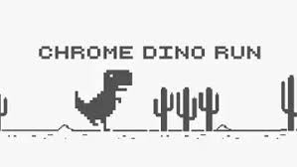
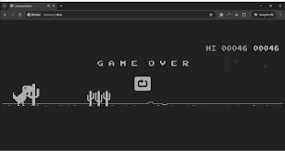
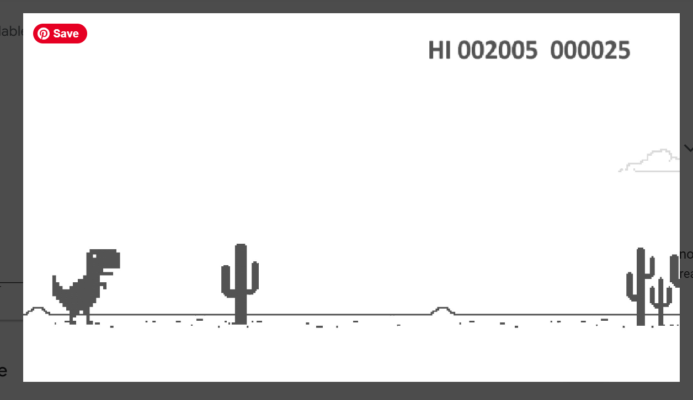
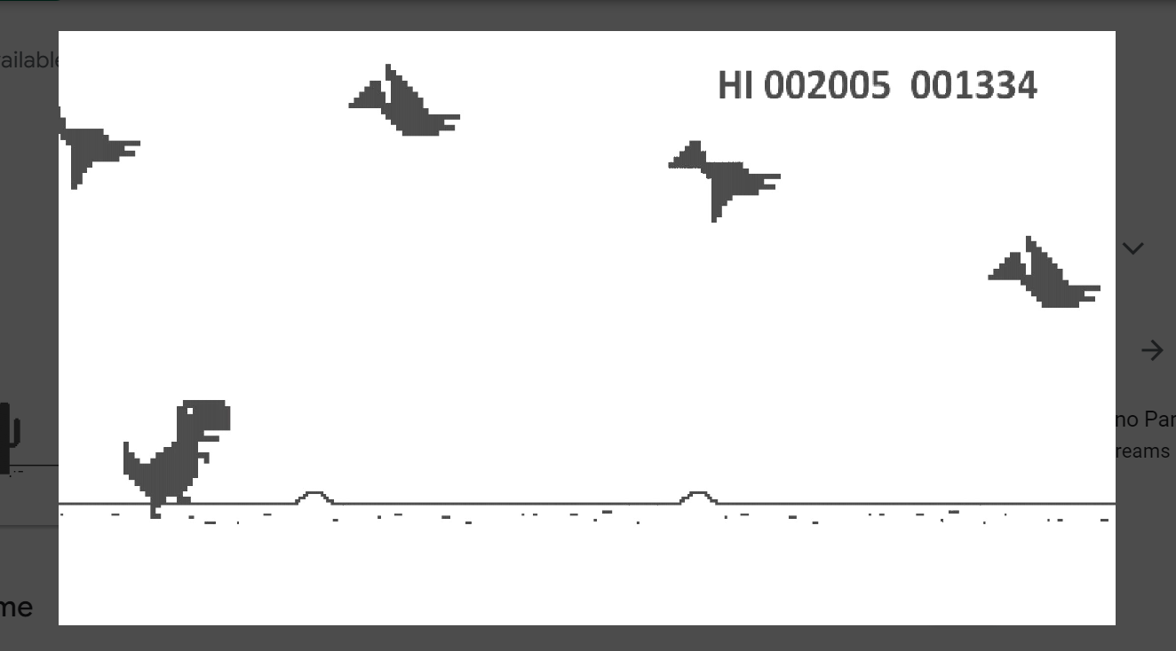
ORIGINAL GAME

Slide 5

02
Methodology And Requirements
Game development methodologies refer to the processes and frameworks game developers use to plan, design, build, manage complexity, ensure quality, deliver and meet deadlines efficiently video games. 1.Concept and Vision:
The core idea or theme, genre of the game. Demographics and preferences of the intended players.
2. Technical Requirements:
Software tools, Unity game engine, C/C++ and C# programming languages, desired frame rate, resolution, load times, and frameworks to be used.
3. Art and Design Requirements:
2D models, textures, animations, audio, Visual aesthetics, including character design, environments, and User Interface (UI).

Slide 6

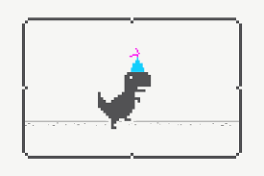


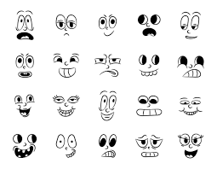



CHARACTER DEVELOPMENT

Slide 7


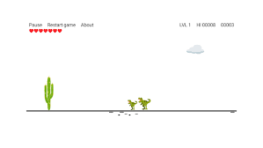



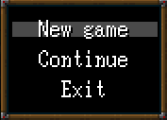


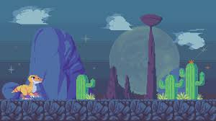


BACKGROUND AND GRAPHICS

Slide 8

03
ADVANTAGES
The game offers an engaging single-player experience with challenging missions and immersive storytelling.
Explore the world of the arcade adventure game, where every corner holds new challenges and exciting discoveries.
Unwind with an offline game that offers a stress-free experience, allowing you to relax and enjoy leisurely gameplay.

Slide 9


dISADVANTAGES
04
The software team worked diligently on updates to fix issues and bugs, ensuring a smoother user experience.
From time to time, new characters are introduced to keep the storyline fresh and engaging.

Slide 10



ur Team
05
Sagarika Srivastava (Leader) Sidra Shaikh Bushra Ansari Sidra Solkar

Slide 11

Conclusion
06
We've explored essential game design principles, effective development strategies, and exciting technological advancements.
Let's continue pushing boundaries, creating immersive experiences that captivate and inspire players worldwide and collaborate to shape the future of gaming!

Slide 12

References
07
Unity Hub 3.9.0 (0916bbd) EDITOR VERSION 2022.3.46f1
© 2024 Unity Technologies https://unity.com/products/unity-engine https://unity.com
https://cloud.unity.com/home/login?redirectTo=Lw==
T-Rex Dinosaur Game - Chrome Dino Runner Online
https://offline-dino-game.firebaseapp.com/
chromedino.com
https://play.google.com/store/apps/details?id=com.deerslab.dinoTREX&pcampaignid=web_share

Slide 13
Thank You !

